Slide 1
Principles of Management

Slide 2
Vishesh completed his MBA at a reputed business school in Lucknow. He was impressed by the principles and techniques of scientific management developed by F.W.Taylor. On completing his MBA, he wanted to apply Scientific Management in his family’s business of fast food chain of restaurants named ‘Burger Mania’. His main goal was to reduce costs with increased output. To begin with, he wanted to develop a standard method which would be followed throughout the organization. So, he investigated traditional methods through work study and unified the best practices. The standard method,i.e., the best way of doing the job was then developed taking into account all parameters right from the procurement of raw materials till the delivery of the final product to the customer. Vishesh also believed that each person should not only be scientifically selected but should also be given the required training to increase efficiency. For this, he set up a special training unit called ‘Hamburger’ in Bengaluru where the workers were given the required training to learn the best method. At the factory, the ingredients making up a burger were strategically placed to reduce the time taken for excess movements. The standard time and other parameters were determined on the basis of work study and Vishesh rewarded the workers for meeting the standard output. Now, ‘Burger Mania’ has standardized processes, raw material, time, machinery, trained staff and working conditions that ensure that the food they send out to their customers has the same high standards of excellence and level of quality in every chain or franchise. The application of Scientific Management to every aspect of restaurant operations led to ‘Burger Mania’s’ widespread success. On the basis of the above paragraph, answer the following questions:

Slide 3
Concept of management
Characteristics of management
Taylor’s scientific management
Fayol’s principles of management
Fayol v/s Taylor and inter-temporal comparisons

Slide 4
Nature of Management Principles
1) Universally applicable: The principles of management are universally applicable in the sense that they are applicable to all organisations irrespective of their nature and size. However, the extent of application may vary from one organisation to another.
2) General guidelines: The principles of management are general guidelines for managerial behaviour and actions in various problems and situations. However, as real business situations are very complex, these principles do not provide straightforward solutions. In other words, the principles are just guidelines for actions and decision making which can be modified according to the situation.
3) Formation: The principles of management were formed by continuous observation and experimentation by managers in different situations.
4) Flexibility: The principles of management are flexible and can be moulded by managers according to a specific situation and circumstance.
5) Behavioural: The principles of management are behavioural in the sense that they influence human behaviour and help in understanding the relationship between human resources and material resources in an organisation.

Slide 5
3. Identify the principle of Scientific Management that helped Vishesh in investigating the traditional methods through work study and unifying the best practices. (Choose the correct alternative) (a) Science not rule of thumb (b) Method study (c) Harmony not discord (d) Cooperation not individualism

Slide 6
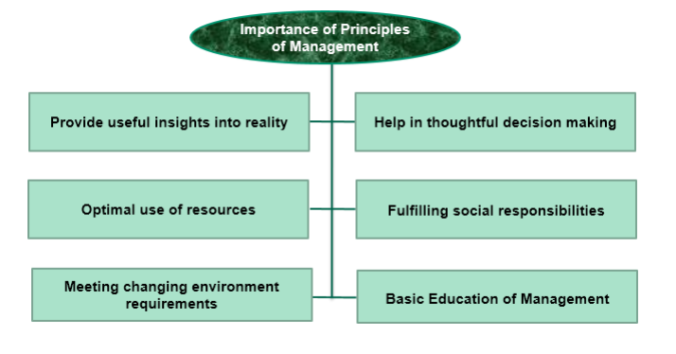
CONTENT SLIDE

Slide 7
Functional Foremanship
• Taylor suggested the division of the factory into two departments: • Planning department • Production department • Each department consists of 4 functional experts to guide, supervise and instruct workers. • Experts in the planning department: o Instruction card clerk: Provides instructions to workers o Route clerk: Shows the route of production o Time and cost clerk: Takes care of the time and cost involved in production o Disciplinarian: Ensures that discipline is maintained • Experts in the production department: o Speed boss: Ensures timely completion of tasks o Gang boss: Keeps machines and tools ready for use by workers o Repairs boss: Ensures that machines work properly o Inspector: Controls the quality of work done Standardisation
• Setting standards for any work or activity • Standardisation can be of process, raw material, time, product, machinery, methods or working conditions • Objectives: o Brand building by assigning fixed categories, sizes and features to the products supplied by any particular company o Making manufactured components/products interchangeable o Achieving standards of quality and reliability of products o Achieving standards of performance of men and machines Simplification of Work
• Eliminates unnecessary varieties, sizes and dimensions of products • Reduces labour and machinery costs • Aims at fuller utilisation of the resources, reducing inventories

Slide 8
Fatigue Study Determines the • Frequency of rest intervals • Duration of rest intervals • Number of rest intervals required while completing a task Causes for fatigue: • Long working hours • Doing unsuitable work • Bad working conditions • Bad relations with boss Method Study • Objective: To find the best way of doing the job among all other methods. • Best Method Results in: Reduction in the cost of production and increase in the quality and satisfaction of customers. Motion study • Refers to the study of motion/movements which are undertaken while performing a particular job and it aims at eliminating unnecessary movements so that work can be completed efficiently and in less time. Time Study • Determines the time taken to perform a particular job • Standard time required to complete a particular task is determined • Determines the number of workers required to complete the task and accordingly determines wages Differential piece wage system • Wages are set as per the standards, and efficient workers, i.e. workers who perform as per the set standards or better than the set standards get higher wages as compared to inefficient workers, i.e. workers who perform below standards. Example: Standard target = 15 units per day Standard rate = Rs 100 per unit Efficient worker who performs better than the standards set Standard Rate: Rs 100 Output produced: 17 units = Rs. 1700 17 100        Inefficient worker Lower rate: Rs 80 Output produced: 12 units = Rs. 960
CONTENT SLIDE

Slide 9
Identify the principles of management

Slide 10
NCERT
WEBSITES

